Slide 1
Software Experimentation
Interactive Media
Unit 1

Slide 2
Starter – As you log in
On your whiteboards: Answer the following question.
What pieces of software have you used for this portfolio so far?

Slide 3
Learning Outcomes
Understand why we use different software for different jobs.
Describe what the purpose of the software used is.
Explain how that software was used and for what purpose.

Slide 4
Choosing the Software
For each of the different pieces of experimentation so far, we have used different pieces of software.
Why didn’t we use Photoshop to make a presentation?
Because it wasn’t the correct tool for the job!

Slide 5
Portfolio Evidence
Part of LO2 requires you to show experimentation with software solutions.
Your work doing experimentation with each section so far will include some evidence for this.
However, in order to make it clear that this section is done, we need more, clear evidence of you using different software.

Slide 6
How to Provide Evidence
For each piece of software you have used, you will need to provide the following work:
The name of the software used.
A description of the software used.
A clear screenshot showing you using that software (you may already have this in your screenshots).
The above information for any other similar products you have used (even if you don’t have evidence for it in your portfolio).

Slide 7
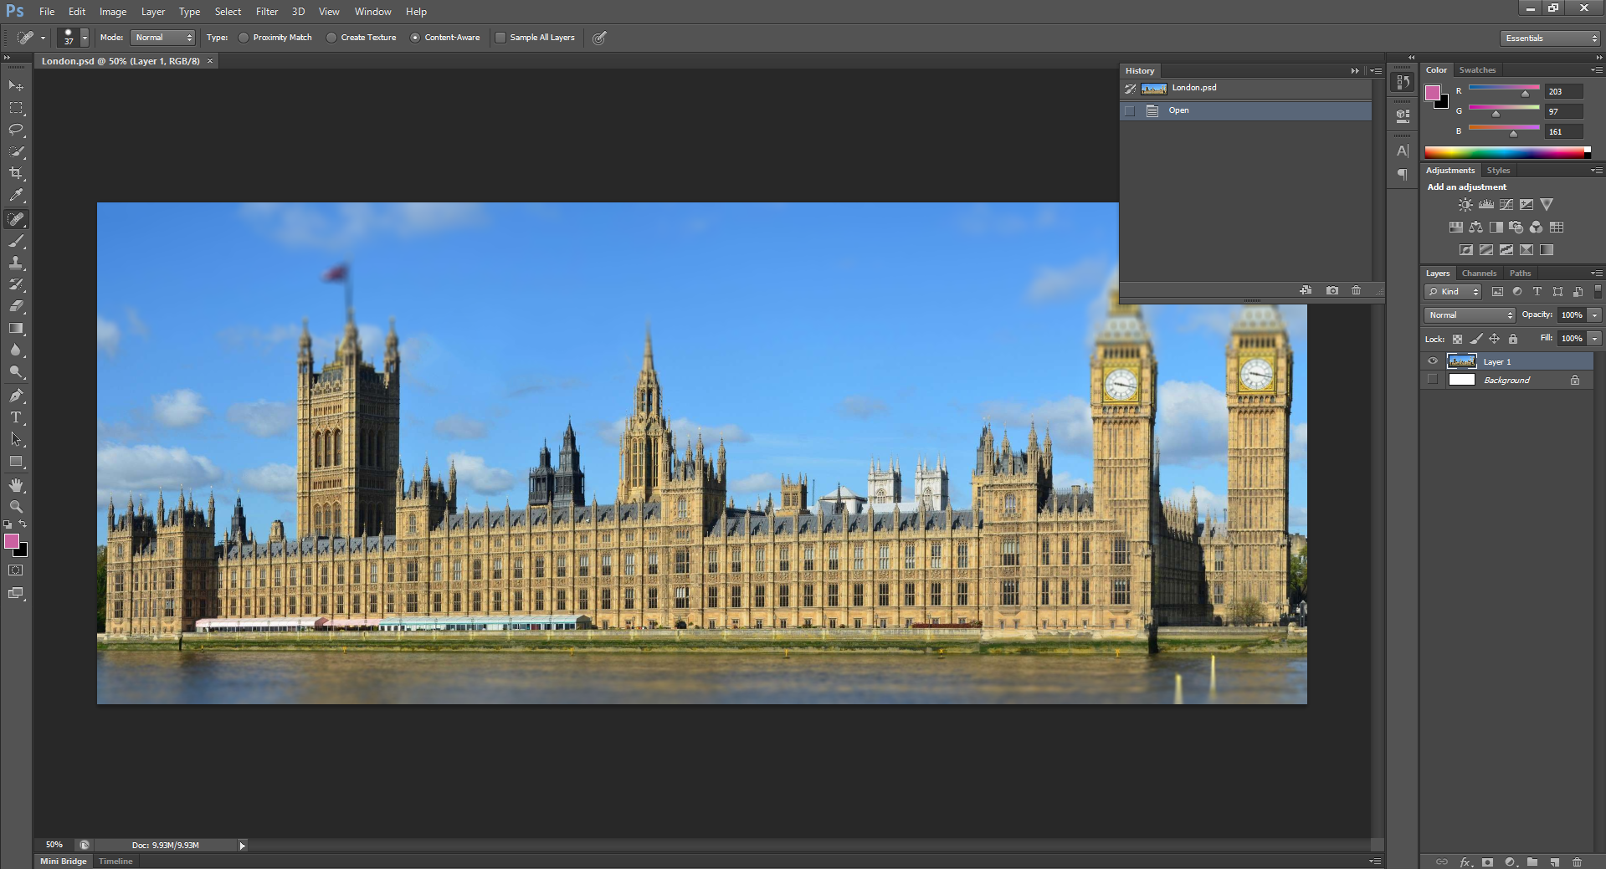
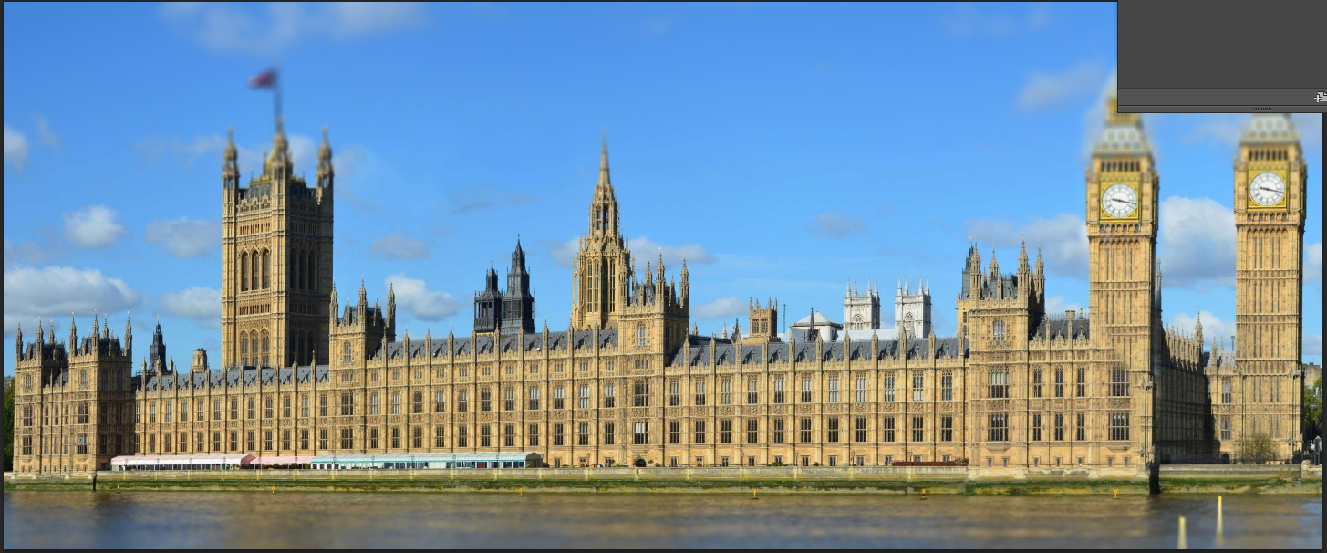
Task 1 – Image Manipulation Evidence
In your portfolio under the existing Image Manipulation heading, before your experimentation, you need to add the following:
The name of the software used. (Adobe Photoshop)
A description of the software used.
A clear screenshot showing you using that software (you may already have this in your screenshots).

Slide 8
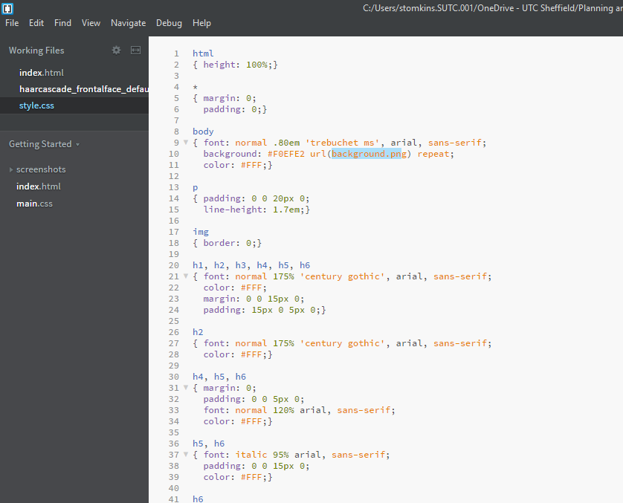
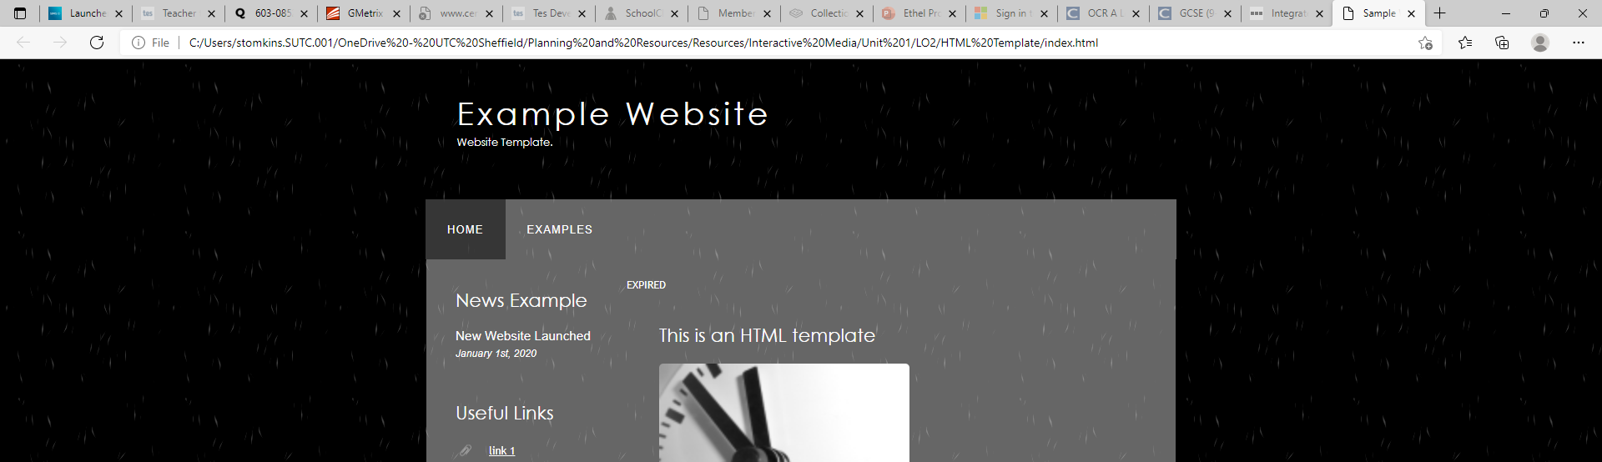
Task 2 – Website Authoring Evidence
In your portfolio under the existing Website Authoring heading, before your experimentation, you need to add the following:
The name of both the software used. (Brackets, Microsoft Edge)
A description of both the software used.
A clear screenshot showing you using that software (you may already have this in your screenshots).

Slide 9
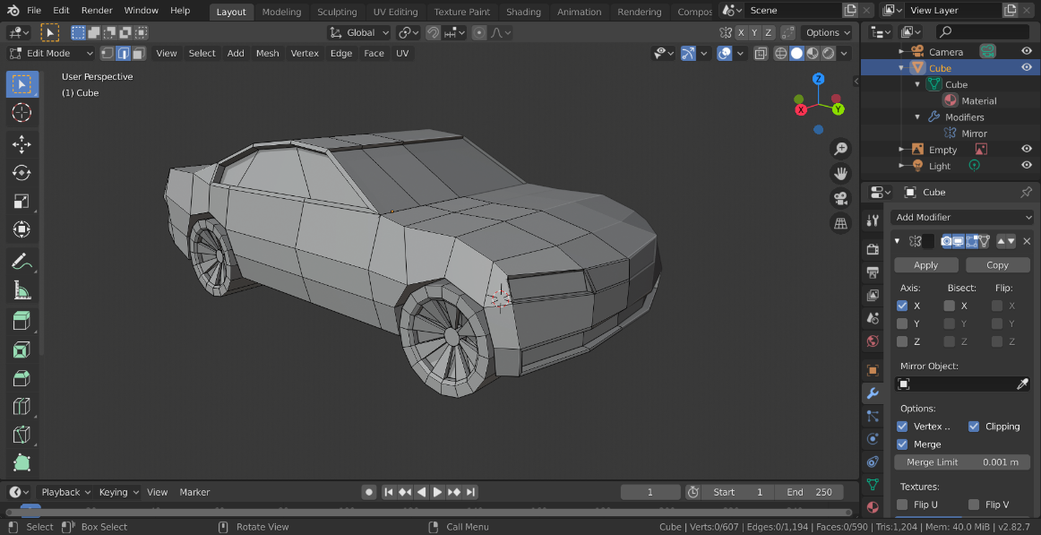
Task 3 – 3D Modelling Evidence
In your portfolio under the existing 3D Modelling heading, before your experimentation, you need to add the following:
The name of the software used. (Blender)
A description of the software used.
A clear screenshot showing you using that software (you may already have this in your screenshots).

Slide 10
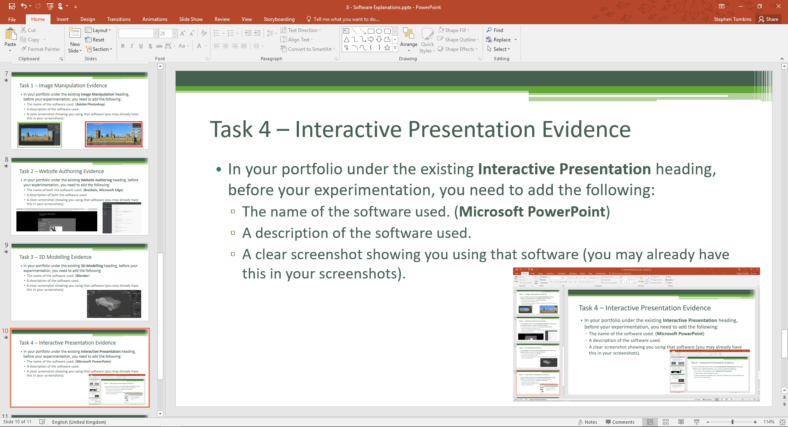
Task 4 – Interactive Presentation Evidence
In your portfolio under the existing Interactive Presentation heading, before your experimentation, you need to add the following:
The name of the software used. (Microsoft PowerPoint)
A description of the software used.
A clear screenshot showing you using that software (you may already have this in your screenshots).

Slide 11
Task 5 – Other Software
If you have used any software other than the ones in-lesson, include the same evidence for each (don’t worry about screenshots if you don’t have any). Some examples include:
Image Editing:
Social Media, e.g. Instagram, Snapchat
G.I.M.P
Paint.NET
Website Authoring:
Adobe Dreamweaver
3D Modelling:
Autodesk
Sketchup
You can also include screenshots of your portfolio in Microsoft Word.

